Slide 1


Wine Variety Prediction
Christian Parker – ML Fall 2023

Slide 2
Features
country
description
designation
points
price
province
region_1
region_2
taster_name
taster_twitter_handle
title
variety
winery

Slide 3
Columns eliminated
designation – 22,214 null values
region_1 – 10,092 null values
region_2 – 34,659 null values
taster_name – We are not interested in making predictions based on who the reviewer is
taster_twitter_handle – Same as taster_name
title – This column has 65,693 unique values which makes it too specific to be useful
winery – crashes VSCode because it has 11,782 unique values

Slide 4
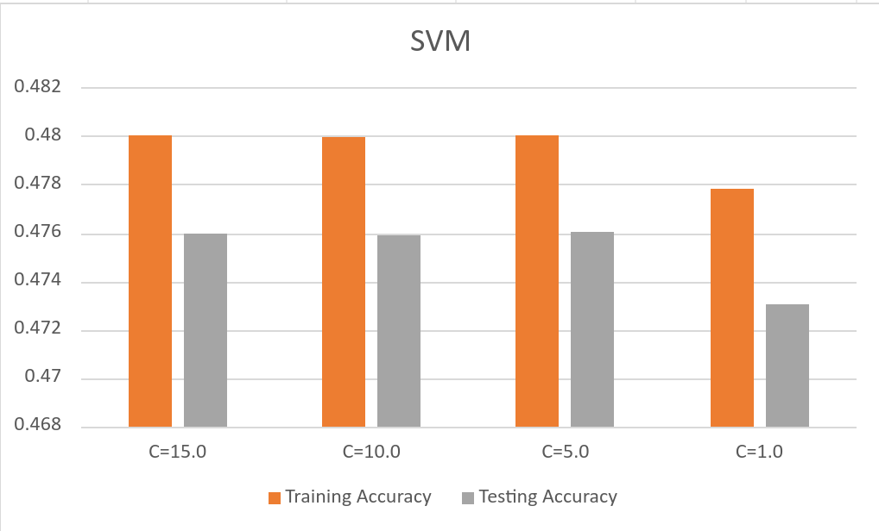
SVM

Slide 5
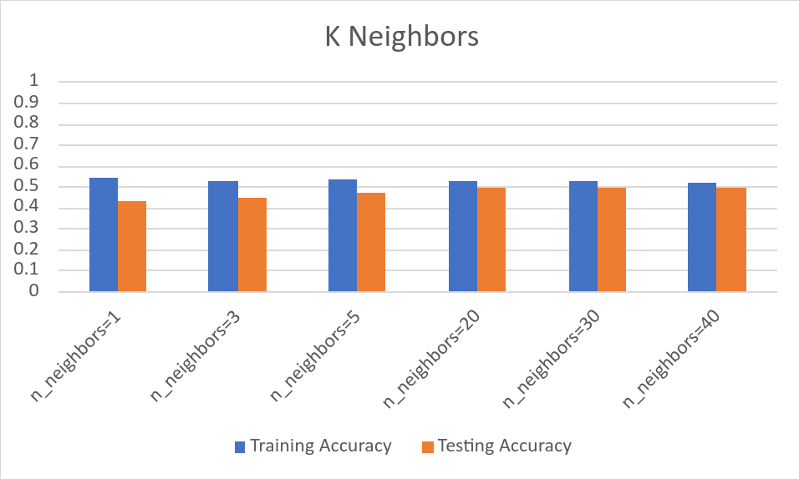
K-Nearest Neighbors

Slide 6
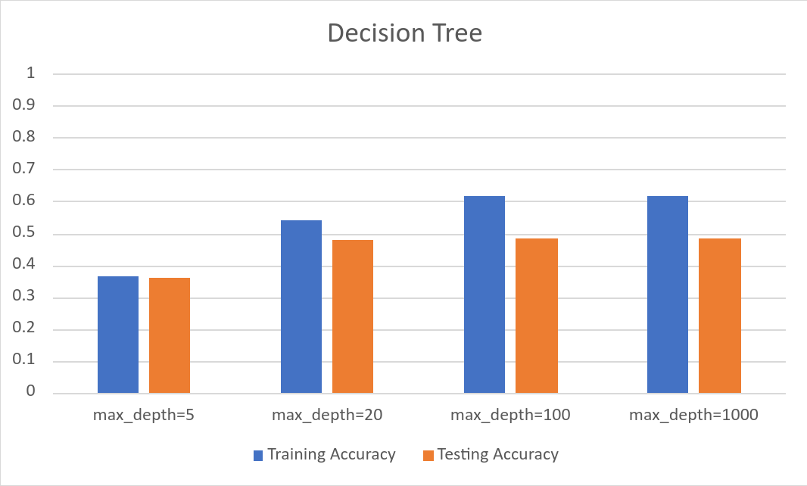
Decision Tree

Slide 7
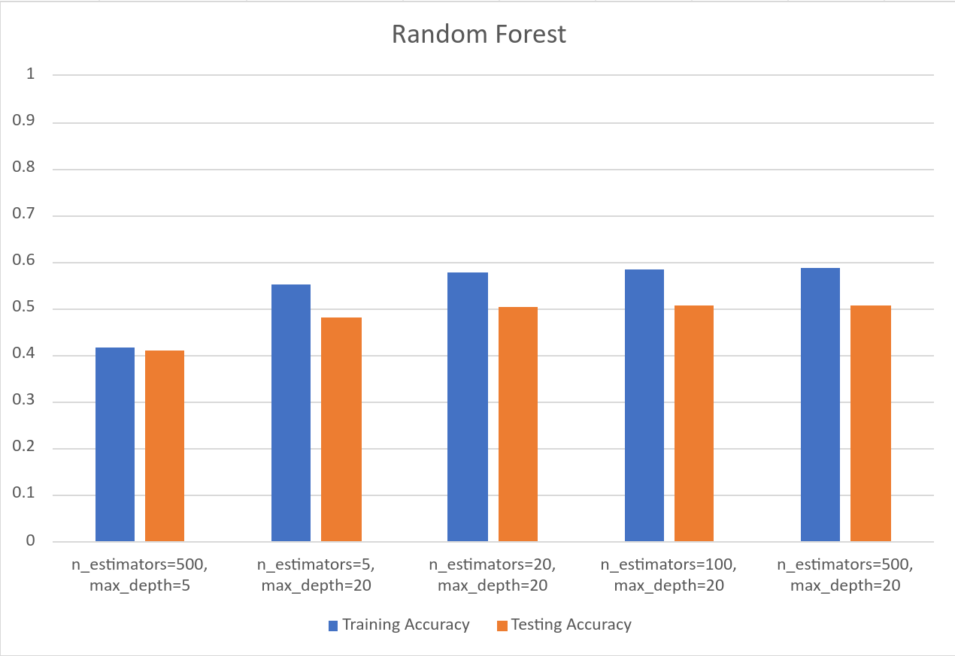
Random Forest

Slide 8
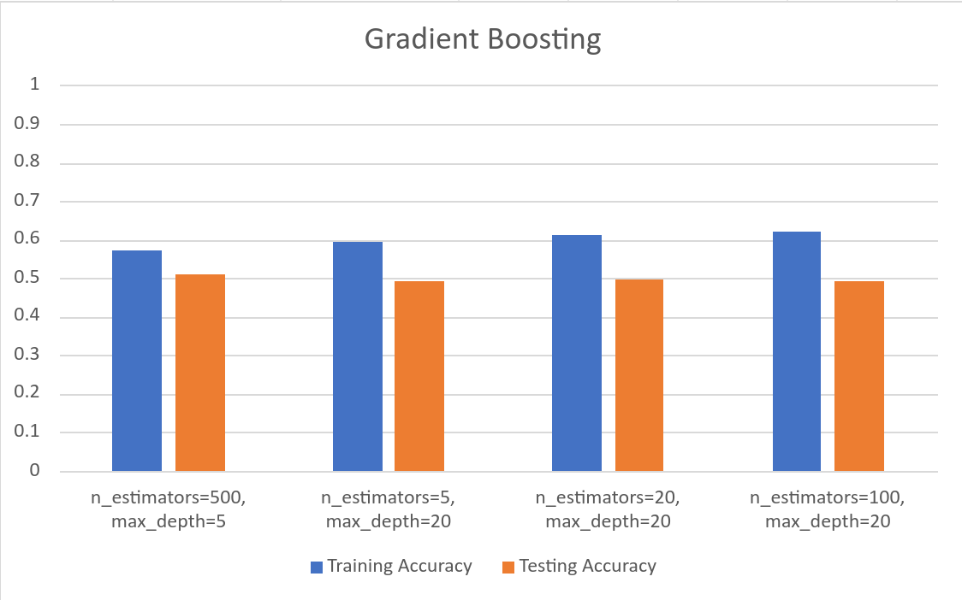
Gradient Boosting

Slide 9
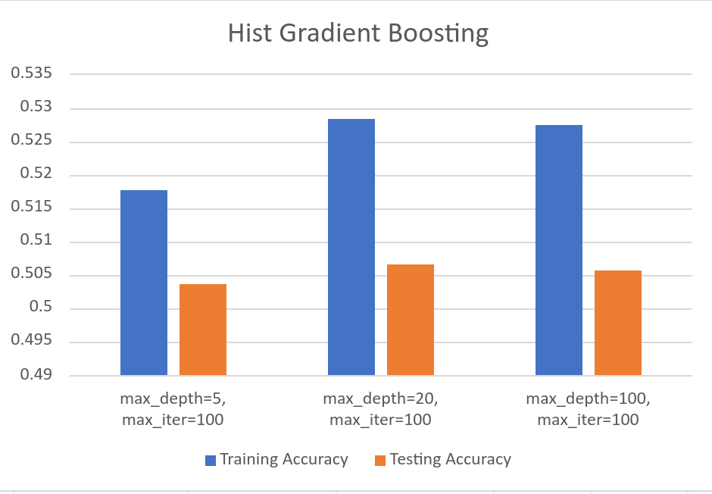
Hist Gradient Boosting

Slide 10
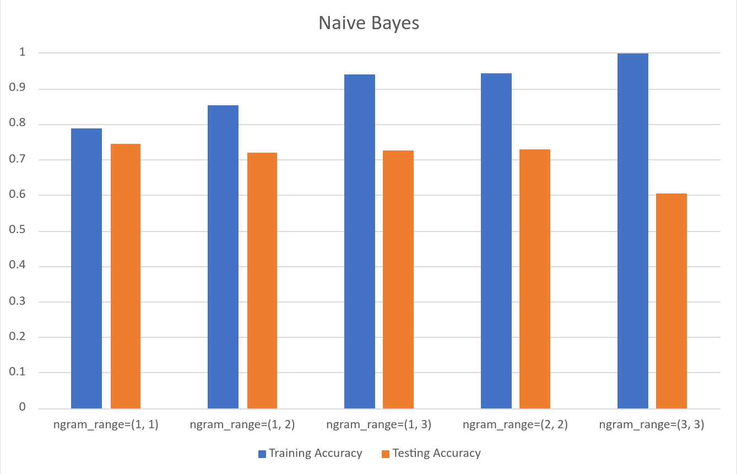
Naïve Bayes

Slide 11
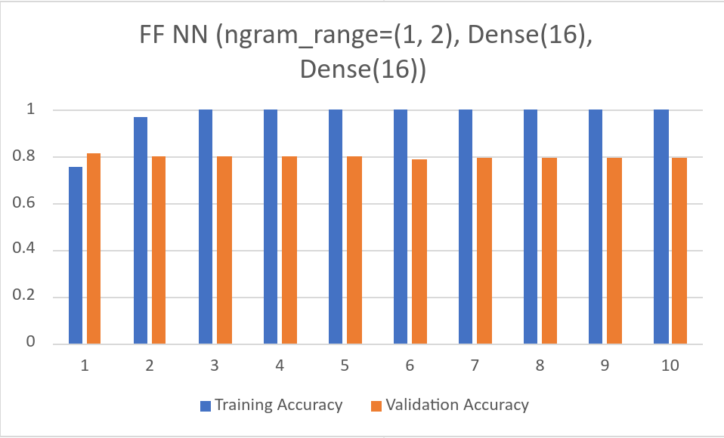
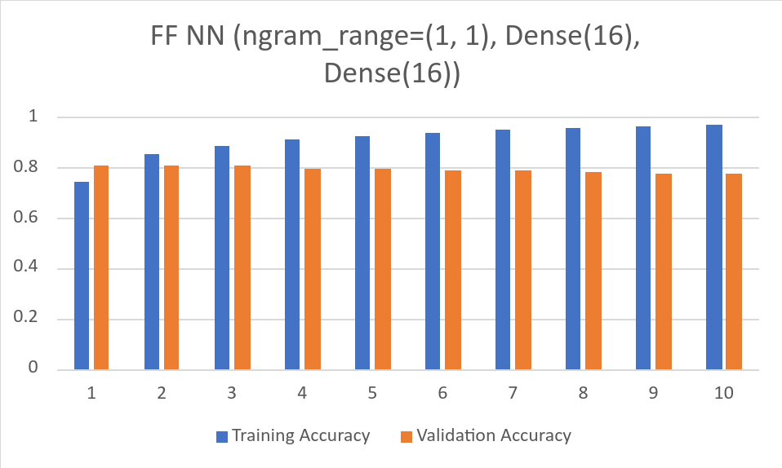

Feedforward Neural Network

Slide 12
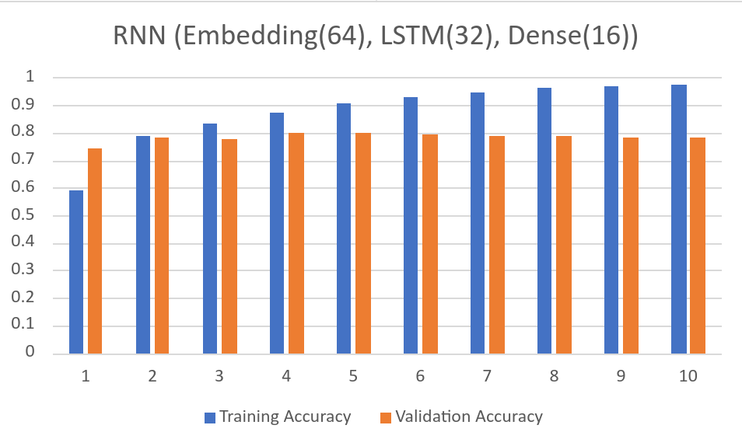

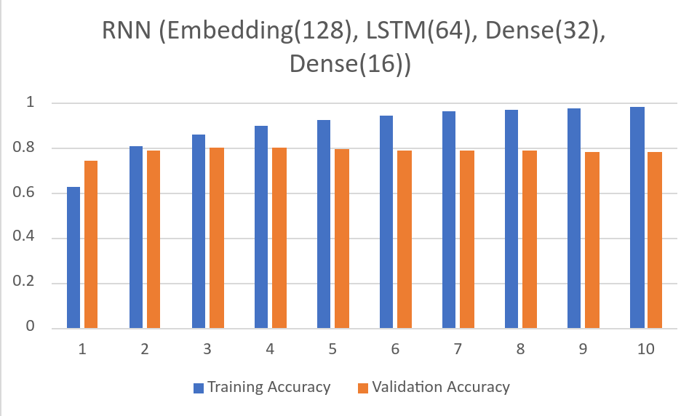
Recurrent Neural Network

Slide 13
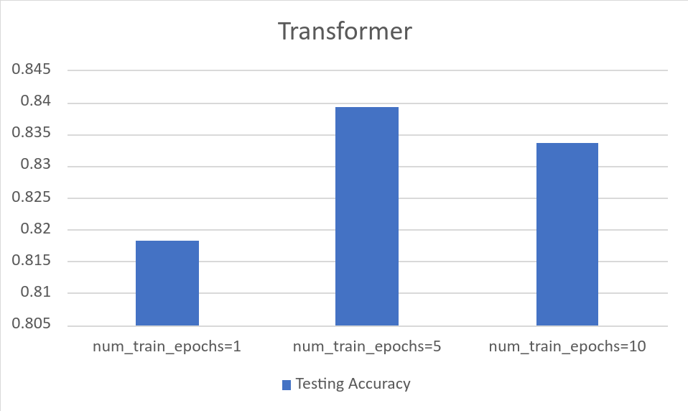
Transformer

Slide 14
Conclusion
0.5 testing accuracy seems to be the peak for point predictions
Description-based predictions performed much better
Transformers performed the best at 0.83 testing accuracy with Recurrent Neural Networks close behind at 0.8

